Slide 1
A User-Centric Machine Learning Framework for Cyber Security Operations Center
CREATIVE AND INNOVATIVE PROJECT REPORT
Submitted by
G. Santhosh 2016103057
S. Ben Stewart 2016103513
P. Udaykumar 2016103622
Guided by
Dr. AR. Arunarani
Teaching Fellow,
DCSE, CEG
Anna University.

Slide 2
ABSTRACT
Datasets from NVD
U.S. Department of Homeland Security’s Computer Emergency Readiness Team (US-CERT)
Generic model that is enough to support additional parameters.
Common Vulnerability Scoring System (CVSS) v3.0 standards.

Slide 3
OUTLINE
PROBLEM STATEMENT
PROBLEM DESCRIPTION
FLOW CHART
SYSTEM ARCHITECTURE
IMPLEMENTATION
PERFORMANCE EVALUATION
CONCLUSIONS
REFERENCES

Slide 4
PROBLEM STATEMENT
To develop a generic model for the cyber security domain because all the machine learning models in this domain have been abstracted as per industry regulations.

Slide 5
PROBLEM DESCRIPTION
Generic model for cyber security domain
Implementation for machine learning
Industry regulations
NVD data set
Test against the CVSS standard

Slide 6

FLOW CHART
Security Information and Event Management
National Vulnerability Database
U.S. Department of Homeland Security’s Computer Emergency Readiness Team (US-CERT)
Common Vulnerability Scoring System (CVSS) v3.0 standards

Slide 7
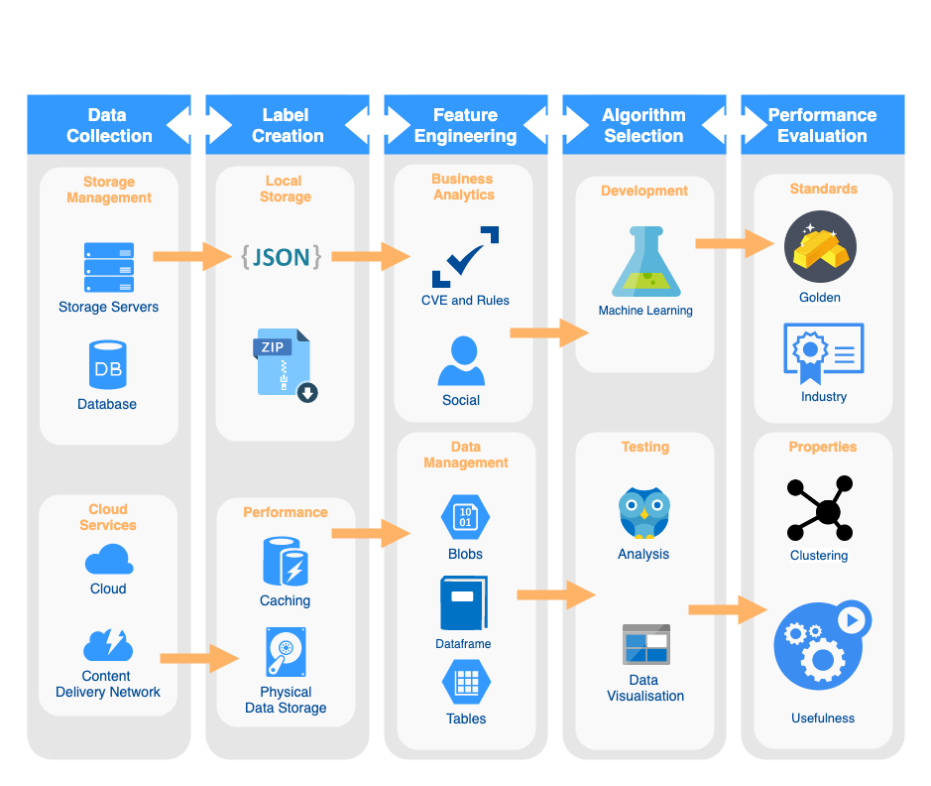

Slide 8
PROPOSED WORK
Data Collection
Label Creation
Feature Engineering
Algorithm Selection
Performance Evaluation

Slide 9
DATA COLLECTION
The data set provided by the National Vulnerability Database maintained by the U.S. Department of Homeland Security’s Computer Emergency Readiness Team (US-CERT) has been used.
Hit the server and concatenate the data into a JSON file.

Slide 10
2. LABEL CREATION
The data was accumulated as JSON files in accordance to the year of data creation.
Due to the file size was a bit large we zipped files for later use and loaded them into our local hard disks.
The caching and retrieval components were provided by Pandas and so we stuck to using the same for developing our machine learning models as well.

Slide 11
3. FEATURE ENGINEERING
The models had been evaluated based on the Common Vulnerability Scoring System (CVSS) v3.0 standards which is commonly followed in the cyber security domain.
But to make the model more generic we also introduced a few parameters for the social factors that would depend on the use case domain.

Slide 12
4. ALGORITHM SELECTION
The models had to be developed on the Lagrangian bias removed data sets and had work in all domains like spam calls, phishing emails and inappropriate conversations in social media.
As a result they had to be tested against the same CVSS standard.
The scalar output with the CVSS standard we could go with the k-means models as they would be efficient and generic enough.

Slide 13
5. PERFORMANCE EVALUATION
Common Vulnerability Scoring System (CVSS) v3.0 standards
Score from 0 to 10 based on the ease to exploit the vulnerability and the industry impact it will be having.
Gold standard.
We will also check the information gain from the clustering of the data points and try to arrive at conclusions.

Slide 14
IMPLEMENTATION
Python with Jupyter Notebook
Pandas, NumPy, BeautifulSoup, matplotlib, sklearn
K-mean cluster
Silhouette analysis cluster size 6
Plot exploitability with impact score for a basic idea
Equifax hack with CVE-2017-5638

Slide 15
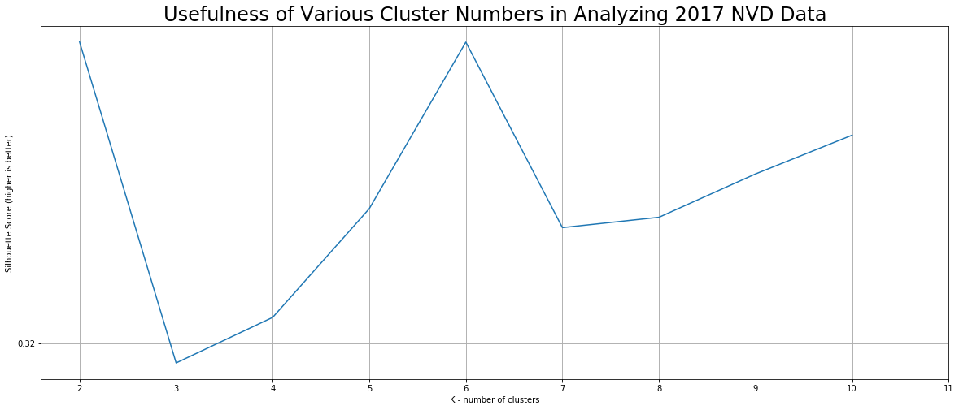
SILHOUETTE SCORE

Slide 16
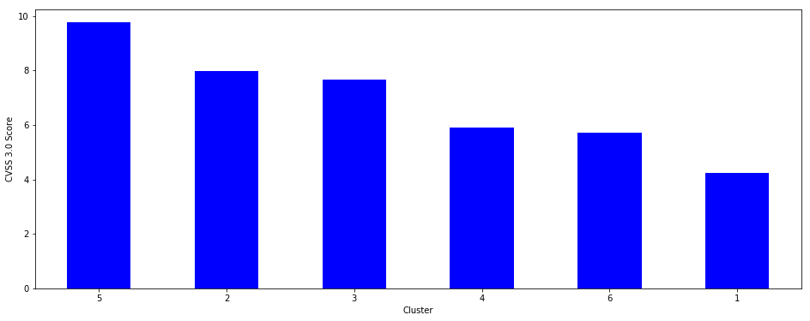
CVSS 3.0 SCORE

Slide 17
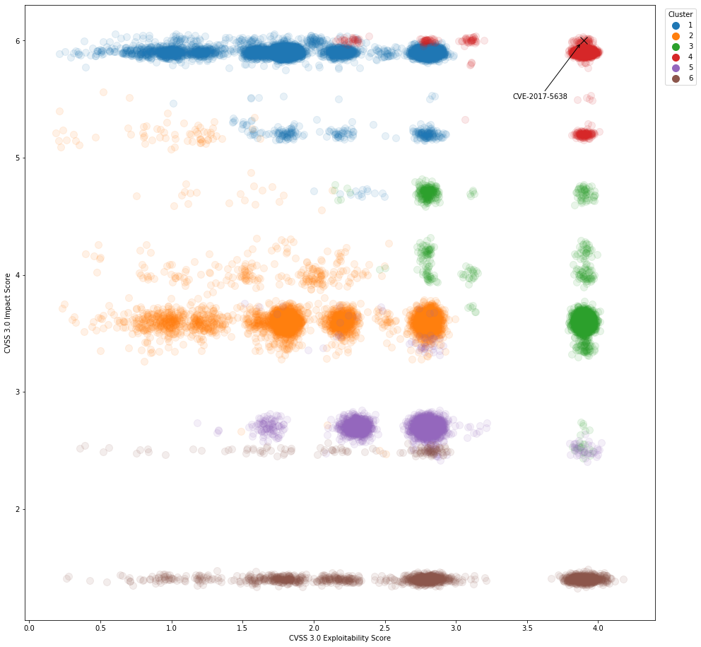
Exploitability Score

Slide 18
CONCLUSIONS
Known vulnerabilities
Form correct clusters based on seriousness
K-mean cluster
rules of thumb
exploitable vulnerabilities are quite common
vulnerabilities share some common characteristics

Slide 19
FUTURE WORK
User Interface
Check if data clustered
Analyse scaling of CVSS 3.0
Construct similar SVM

